Slide 1
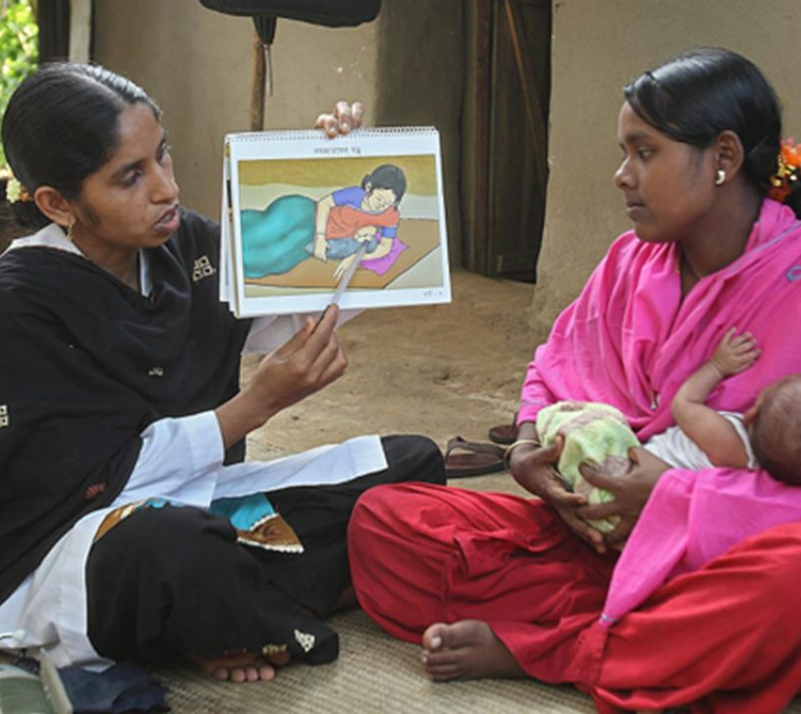

Shaako
Building Bridges to Better Health
A one stop solution for Community Health Worker Programs

Slide 2
World Health Shortage
50%
5 million
18 million
World population without access to the essential health services
Premature deaths due to poor-quality health care
The shortage of health workers by 2030

Slide 3
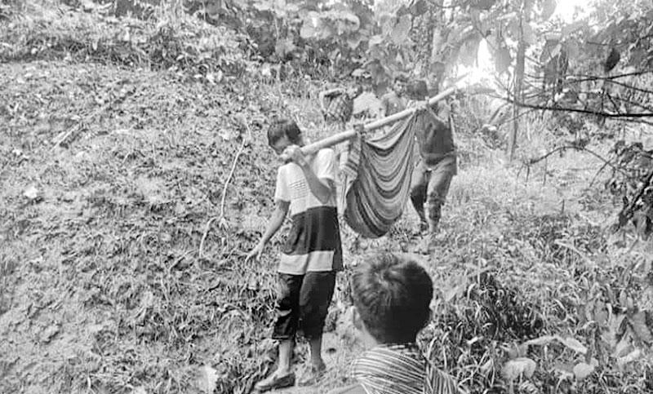
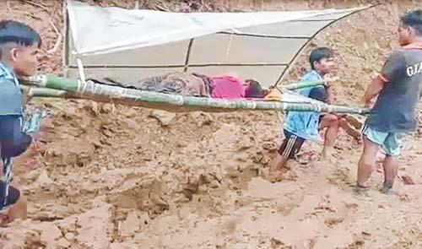
Pregnant woman carried on bamboo stretcher for 80 kms, gives birth at CCpur Hospital, India
Emergency patient being carried on shoulders at Karmadha Union, Kulaura, Moulvibazar, Bangladesh.

Slide 4
Community Health Workers

Slide 5

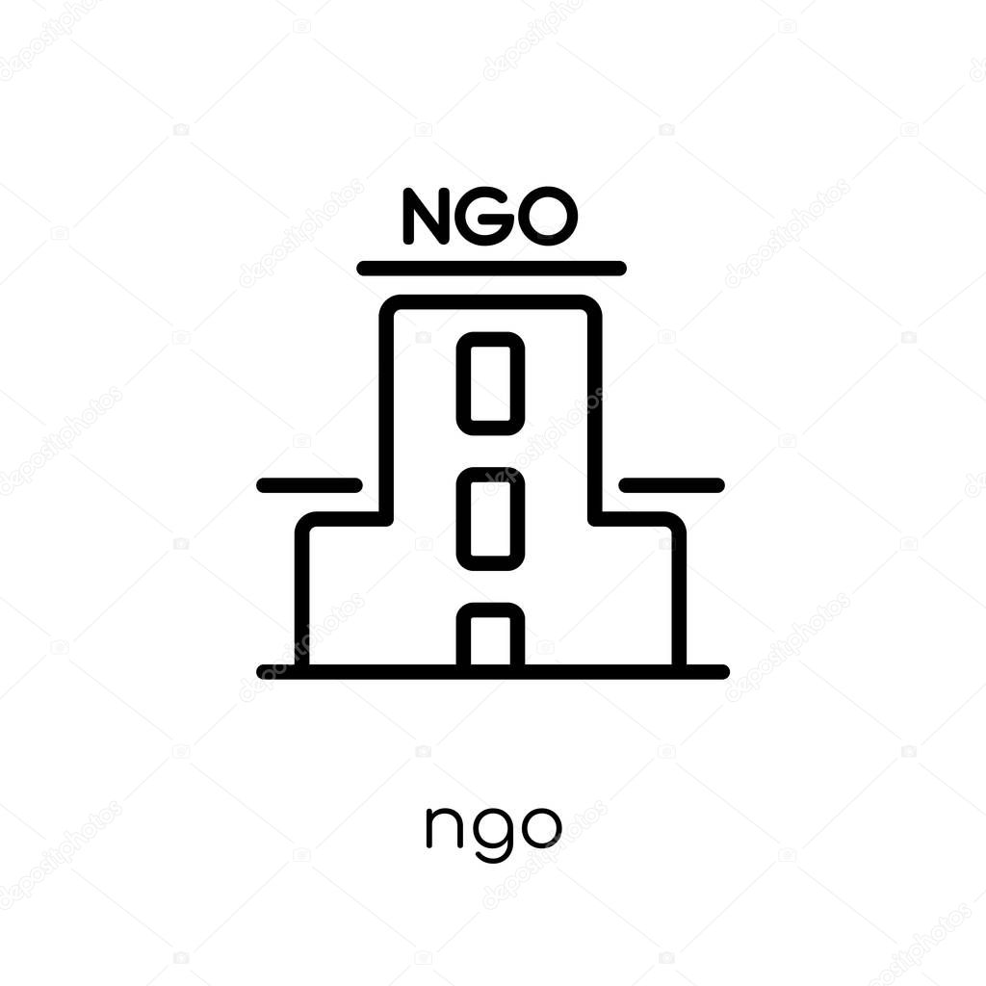


How CHW Programs Work
Supervise and Supply
Assess, Treat and Educate
Government, NGO, or Organizations
Supervisors
CHWs
Community

Slide 6
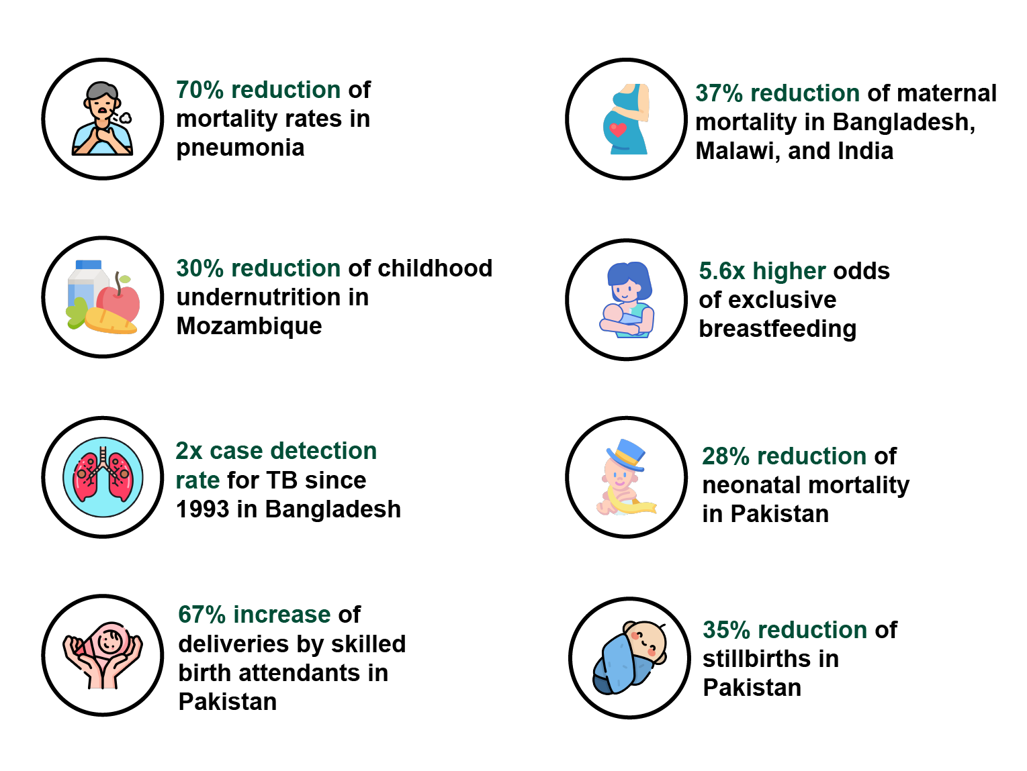
Impacts of CHWs

Slide 7




Challenges Faced in CHW programs
Insufficient and out-dated training
Memorizing technical details is hard
Lots of documentations and paperworks
Unmonitored workload and unrealistic goals

Slide 8

Shaako System

Slide 9
CHW Module
For Community Health Workers

Slide 10


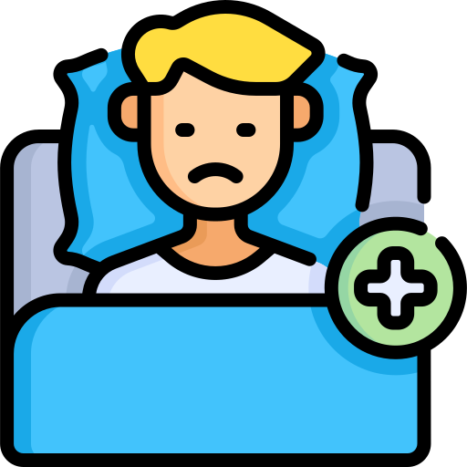

Features
Downloadable and self-paced training materials.
Quiz module that provides knowledge reinforcements to the users. The scores can be sent to supervisors for evaluations and remunerations.
Convenient patient registration and monitoring. Patient visit history can be stored to track disease trends.
A symptom-based disease predictor that helps the CHWs diagnose diseases better.
Training materials.
Quiz Module
Patient Monitoring
Disease Predictor

Slide 11



Features
Locations to nearby medical facilities.
Emergency contacts to hospitals, ambulances and pharmacies.
Instant notification updates.
Medical Facility Location
Emergency Contacts
Notification Update

Slide 12

Authority Module
For NGOs and Supervisors

Slide 13



Features
Upload training contents and create quizzes for health campaigns.
Register, monitor and evaluate recruited CHWs
Create push notifications for the registered CHWs.
Automated stats on specific regions and CHWs
Upload training contents
Evaluate recruited CHWs
Create push notifications
Automated stats

Slide 14




Beneficiaries
CHWs
NGOs
Patients
CHW Supervisors
Government
Lessons
Less Paperwork
Automatic Report Generation
Community
Managing
Tracking
Recruitment
Instant Data Collection
Symptoms monitoring
Quick hospital support
Decreased training cost
Increased efficiency
Improvement in healthcare Indexes
Providing contents
Management
Evaluation

Slide 15
MAIN COMPETITORS
 | Lesson | Region Independent | Patient Monitoring | Supervision
CHW Lite
Safe Pregnancy and Birth
Community Health Academy
Boost

Slide 16
Feasibility
01
Smart phones and internet connections are enough for this system.
Technical Feasibility
02
The medi-tech industry is booming. As we have better features and supports than the competitors we will have good market opportunity
Market and Financial Feasibility
03
As the government and the NGOs are the main beneficiaries this system will be able to operate easily.
Operational Feasibility

Slide 17
Modules and Submodules
CHW Module
Patient module
CHW Training module
Location module
Disease predictor
Authority Module
Statistics generation
Recruit and evaluate CHWs
Launch new campaigns

Slide 18



Our Team
Iftekhar Hakim Kaowsar
Rasman Mubtasim Swargo
Apurba Saha
1705045
1705051
1705056

